Slide 1
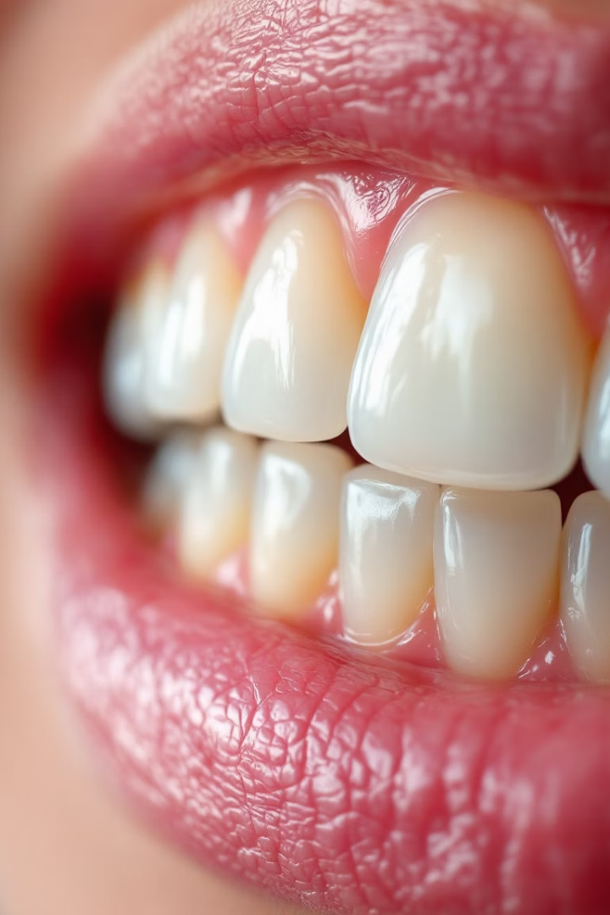

Dental Restoration Color Matching Technology
Welcome to Part 5 of the Dental Restoration Fabrication Series. This session explores the science and art of matching restoration colors to natural teeth.
作者：BO Gao

Slide 2
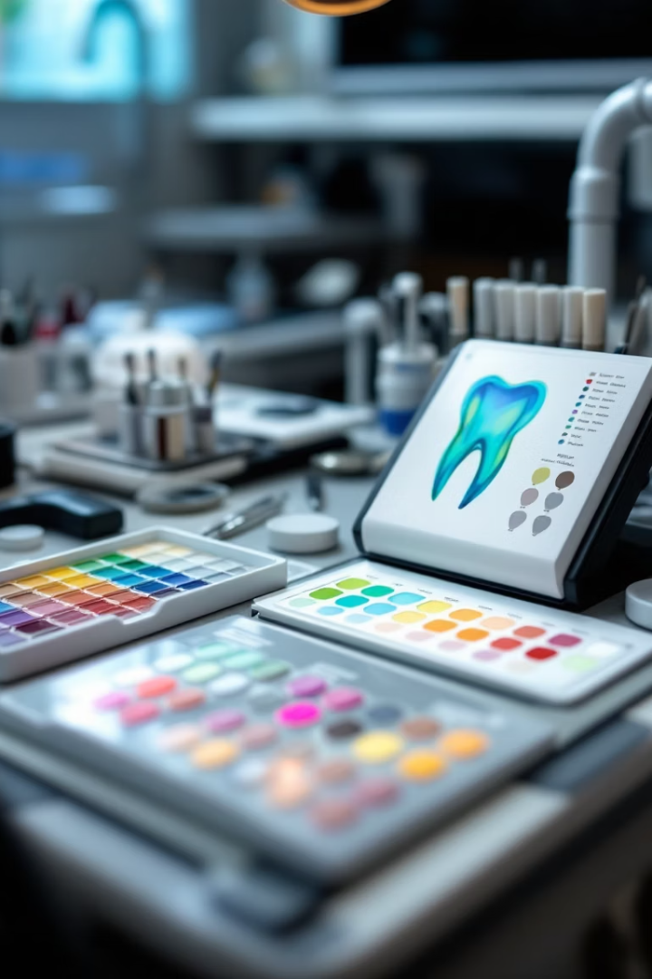





Course Overview
Basic Color Theory
Fundamental principles that govern how we perceive color in dentistry.
Natural Teeth Characteristics
Understanding the unique optical properties of natural dentition.
Gingival Characteristics
How to match the color and texture of surrounding soft tissues.
Matching Techniques
Practical methods for achieving seamless color integration.

Slide 3
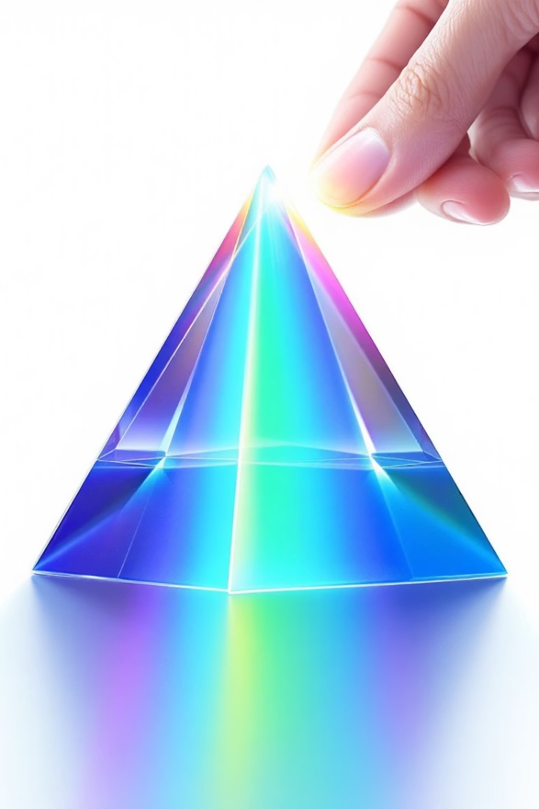




Color Formation Principles
Light Source
Illumination is essential. No light means no color perception.
Object
Teeth reflect, absorb, and transmit light in unique ways.
Eye
Receptors capture the reflected wavelengths.
Brain
Neural processing interprets these signals as color.

Slide 4
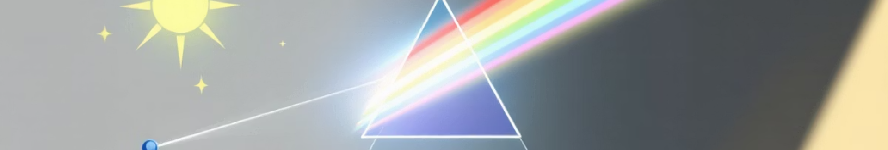
Optical Basis of Color
Visible Spectrum
Seven Colors
Light wavelengths between 380-780 nm that humans can perceive.
Red, orange, yellow, green, cyan, blue, and purple form the spectrum.
1
2
3
Newton's Prism
Demonstrates how white light separates into component colors.

Slide 5
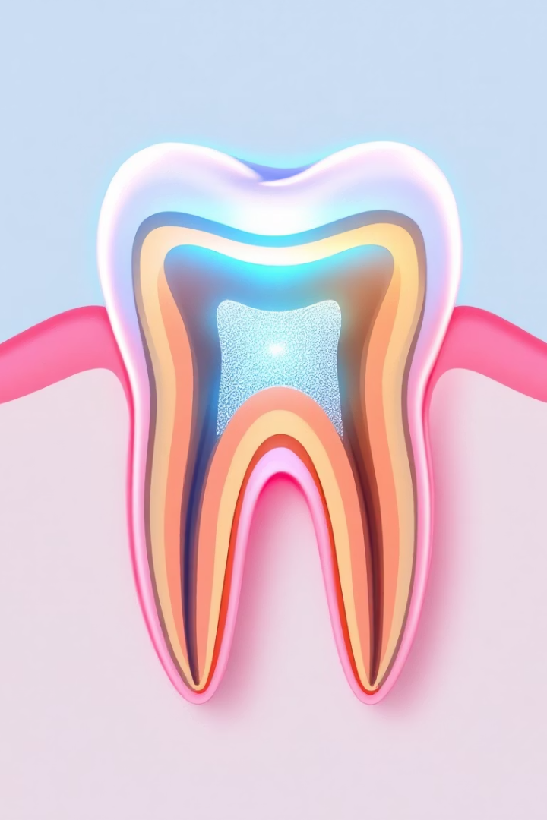
Object Color Properties
Surface Color
Transparent Color
Opaque objects reflect light without transmission. Most restorative materials have this property.
Light passes through with minimal scattering. Rare in dental materials.
Semi-Transparent
Natural teeth allow some light transmission while reflecting and absorbing portions.

Slide 6
Color Classification
Chromatic Colors
Achromatic Colors
Colors with hue, chroma, and value properties.
Colors with only value (lightness) properties.
Red, orange, yellow, green
White (highest value)
Cyan, blue, purple
Black (lowest value)
All their mixtures
Grayscale (intermediate values)

Slide 7
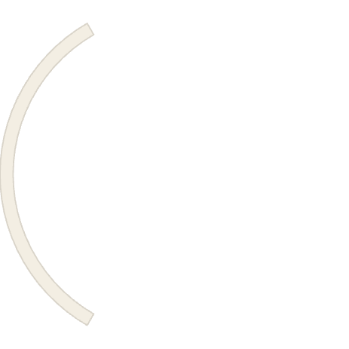
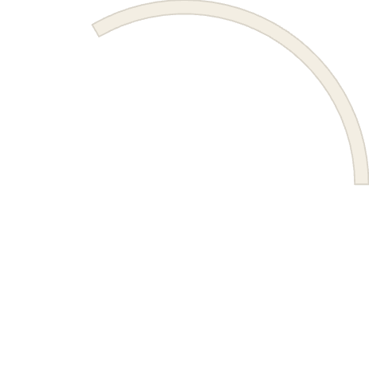




Three Elements of Color
Chroma (C)
Color purity or saturation. Adding white or black reduces chroma.
Hue (H)
The basic tone of color. Teeth have limited range, mainly reddish or yellowish.
Value (V)
Lightness or darkness. Yellow has high value; red and blue have lower value.

Slide 8
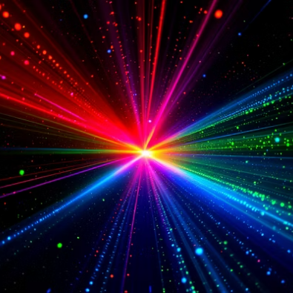
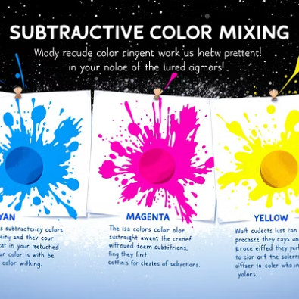
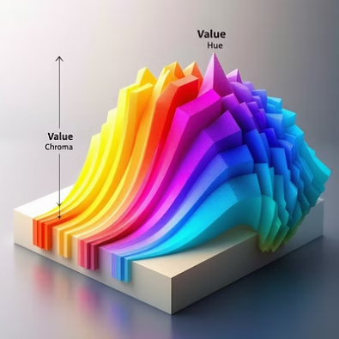
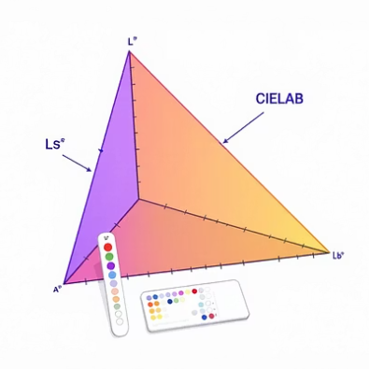
Color Mixing Systems
Dentistry uses both additive (light) and subtractive (pigment) color principles. The LAB system is most common for precise dental color matching.

